Slide 1

Priti Patel

Slide 2
Lecture Content
Introduction to clinical pharmacy
Definition : Clinical Pharmacy, Community pharmacy and hospital pharmacy
scope and objectives
responsibilities of clinical pharmacist in hospital patient care area, wards, retail pharmacy,

Slide 3
Learning Objectives
understand the basic concept of clinical pharmacy
enlist the role and responsibilities of clinical pharmacist, hospital pharmacist, community pharmacist
define: Clinical Pharmacy, Community pharmacy and hospital pharmacy

Slide 4
Health Care System
Composed of physician (including other medical and dental staffs), pharmacist , nurse and other paramedics
Physician ; diagnosis, prescription, monitoring, medical care
Pharmacist; prescription*, dispensing, counseling, monitoring, pharmaceutical care
Nurse ; administering, monitoring, nursing care
Other paramedics ; their own work
Load to physician & nurse ; high due to the system of "physicians are all in all in hospital for the treatment of patient, with the help of nurse."
Concept of normal public/patient ; same

Slide 5
Perceptions of Pharmacists
How do others see us?

Slide 6
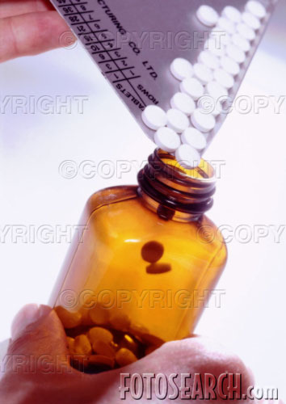
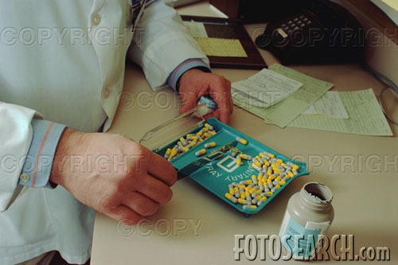
“They just count a few tablets”

Slide 7
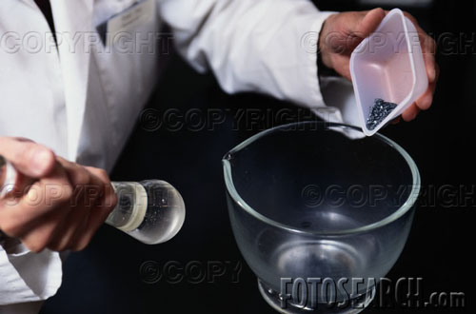

“They just weigh and measure things”

Slide 8
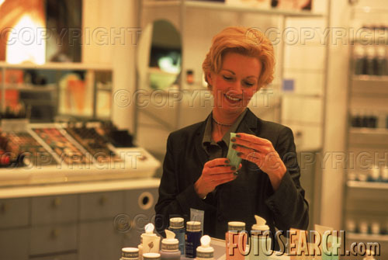
“A bunch of shop-keepers”

Slide 9
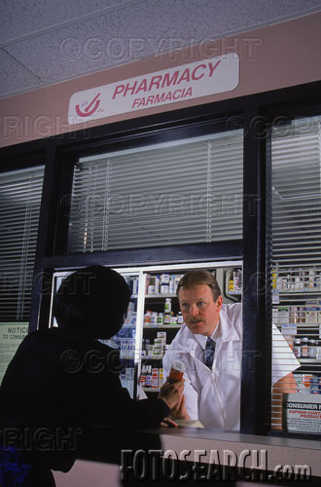
“Tell me how and when to use the Medicine”

Slide 10

“Counter-prescribing”

Slide 11

“Not really health care practitioners –
they’re businessmen”

Slide 12
Pharmacists are allied health professionals who practice in pharmacy, the field of health science focusing on safe and effective medication use
Specialities of Pharmacists
Expert in Science & Clinical use of medications.
Knowledge about Composition & Properties of drug
Various categories of diseases & Classification of drugs
Therapeutic dose of drug
Structure Activity Relationship of drug of drug
Body Mechanism & Structure
Understand the Pharmacological & Mechanism of Action of Drug
Have analytical skills & clinical knowledge
Information about Adverse Drug Reaction & toxic effects of Drug
Familiar with Medical terminologies

Slide 13
Introduction; Clinical Pharmacy
The term “Clinical” implies the practice of pharmacy in presence of patients whether they are hospitalized or ambulatory, out patients or at home.
Clinical pharmacy may be defined as the science and practice of rationale use of medications,
“The area of pharmacy concerned with the science and practice of rational medication use.”
where the pharmacists are
more oriented towards the patient care
rationalizing medication therapy
promoting health , wellness of people.

Slide 14
Clinical Pharmacy is a health science discipline in which pharmacists provide patient care that
optimizes medication therapy and
promotes health, wellness, and disease prevention.
The practice of clinical pharmacy embraces the philosophy of pharmaceutical care; it blends a caring orientation with specialized therapeutic knowledge, experience, and judgment for the purpose of ensuring optimal patient outcomes.
As a discipline, clinical pharmacy also has an obligation to contribute to the generation of new knowledge that advances health and quality of life.

Slide 15
Clinical pharmacists care for patients in all health care settings.
They possess in-depth knowledge of medications that is integrated with a foundational understanding of the biomedical, pharmaceutical, sociobehavioral, and clinical sciences.
To achieve desired therapeutic goals, the clinical pharmacist applies evidence-based therapeutic guidelines,
evolving sciences,
emerging technologies, and
relevant legal, ethical, social, cultural, economic and professional principles.

Slide 16
Accordingly, clinical pharmacists assume responsibility and accountability
for managing medication therapy in direct patient care settings,
whether practicing independently or in consultation / collaboration with other health care professionals.
Clinical pharmacist researchers generate, disseminate, and apply new knowledge that contributes to improved health and quality of life.

Slide 17
Within the system of health care,
clinical pharmacists are experts in the therapeutic use of medications.
They routinely provide medication therapy evaluations and recommendations to patients and health care professionals.
Clinical pharmacists are a primary source of scientifically valid information and
advice regarding the safe, appropriate, and cost-effective use of medications.

Slide 18









How does clinical pharmacy differ from pharmacy?
The discipline of pharmacy embraces the knowledge on
synthesis, chemistry and preparation of drugs
Clinical pharmacy is more oriented to the
analysis of population needs with regards to
medicines,
ways of administration,
patterns of use ,
drugs effects on the Patients,
‘the overall drug therapy management’.
The focus of attention moves from
“the drug to the single patient or population receiving drugs”.

Slide 19
Objectives and Goals
The mission of clinical pharmacy practice is to render
“Pharmaceutical Care”
It focuses on the
Pharmacist's attitude
Behaviour
Commitment
Concern
Ethics
Knowledge
Responsibilities and
Skills
on the provision of drug therapy with the goal of achieving definite outcome towards the improvement of patients
“Quality of Life”

Slide 20
Clinical Pharmacy Requirements
Knowledge of
drug therapy
Knowledge of
nondrug therapy
Knowledge of
the disease
Therapeutic
planning
skills
Knowledge of
laboratory
and diagnostic skills
Patient care
Drug Information
Skills
Communication
skills
Physical
assessment
skills
Patient
monitoring
skills

Slide 21
Functions of Clinical Pharmacists
Taking the medical history of the patient (through admission and discharge interviews and from patient databases and medical records)
Patient Education and counseling
3. Patient care : (Monitoring drug therapy, including routine analysis of patients drug therapy, medical problems, laboratory data and special procedures.)
4. Formulation and management of drug policies (Provision of written consultations in such areas as total parentral nutrition, IV therapy, Clinical Pharmacokinetics, selection of drug therapy and determination of therapeutic end points. The pharmacist correlates these analyses with direct observation and communicates his observation to clinician responsible for the patient care)
5. Drug information ( Providing up-to-date, unbiased, current drug information on all aspects of drug therapy)
6. Teaching & training to medical and paramedical staff (Participation in the education of medical, pharmacy and nursing personnel in the patient care)

Slide 22
7.Participation in drug utilization studies ( control of medication administration and drug distribution in the patient care areas)
8. Dosage optimization and individualization (TDM and providing clinical pharmacokinetic services)
9. Participation in management of medical emergencies (e.g. CPR, Drug overdose, toxicities, poisoning, antidotes, and providing first aid)
10. Detection and reporting of Adverse drug reactions
13.Safe use of drugs (Conduct of drug use review programme and participation in patient care audits)
14.Disease management cases (Management of patients with chronic diseases such as hypertension, diabetes mellitus, COPD, Arthritis, and cancer in cooperation with medical staff)
15. Research and development (Initiation and participation in clinical drug investigations in collaboration with appropriate members of medical staff.)

Slide 23
The most common pharmacist positions are:
community pharmacist (also referred to as "retail pharmacist" or
“dispensing chemist"),
What is Community Pharmacy?
Practice of pharmacy based within the community
Primarily located within a retail setting
Business
Centre for healthcare
hospital pharmacist (also known as a clinical pharmacist)
.

Slide 24
Responsibility of clinical Pharmacists In
(Hospital's Patient Care Areas)
Supervision of drug administration techniques.
2) Reviewing of each patient's drug forms periodically to ensure all doses have been administered and recorded correctly.
3) Reviewing of a doses missed, rescheduling the doses as necessary and ensuring that the drug administration forms are transcribed accurately for drug therapy and
that drug continuity of charges are correctly assessed.
4) Reviewing and interpreting each unit dose and lv admixture medication order to ensure that it is entered accurately and that the physician is informed of all automatic stop orders.

Slide 25
5) Assisting the technicians as needed in dealing with difficult patients and new treatment procedures etc.
6) Acting as liasion between the technician and the nursing and the medical staff.
7) Ensuring that correct drug supplies are maintained in the wards and coordinating all pharmacy services within the hospital.
8) Providing in-service education to pharmacists, interns, residents, nurses and medical students.
9) Providing drug information to physicians and nurses.

Slide 26
Responsibility in Direct Patient Care Areas (Wards)
identifying drugs brought into the hospital by patients
2) Obtaining patient medication history and communicating all pertinent information to the physicians.
3) Assisting in drug product and entity selection.
4) Assisting the physician in selecting dosage regimen and schedule and assigning drug administration times for these schedules.

Slide 27
5) Monitoring patient's total drug therapy for effectiveness, ineffectiveness, side effects, toxicity, allergic drug reactions and drug interactions.
6) Counselling patients on medication to be self administered and discharge medication
7) Maintaining patient drug profiles and participating in drug monitoring programmes.
8) counselling the patients in proper use of drugs as well as advising appropriate precautions, issues warnings and gives contra-indication alerts.
9) Describing and training in the use of health care accessories like inhalers, orthopaedic aids, diabetic supplies etc.
10) Providing guidance in public and preventive health education programmes on timely topics like drug abuse, first aid, contraception and vaccination.

Slide 28
Clinical Pharmacist in Community (Retail) Pharmacy
The retail pharmacist can expand his pharmacy practices by providing significant clinical services and personalized patient care from which his clients may be greatly benifited.
The following are the services that may be offered by a pharmacist at retail drug stores.
Referral Service
The community pharmacist may act for the patients as a portal of entry into the health care system. He may guide them to the physicians and help in locating the appropriate health
professionals and specialists. He may develop physician accepted criteria for referral of patients.
This could avoid delays in treatment of acute and chronic illnesses.

Slide 29
2) Personalised Patient Care Services
When patients on long term therapy return for prescription refills it offers the pharmacists a good opportunity to monitor their response to drugs, to detect adverse drug reactions harmful drug interactions, to note their response to therapy, to discern their compliance or non-compliance and to answer any questions they may have regarding their medication.
He also maintains complete patient drug profiles so that he can predict any prescription duplication or possibilities of drug misuse or abuse. He can counsel the patients on safe drug use and storage conditions of drugs.

Slide 30
3) Clinical Services
The pharmacist at the counter can help in patient monitoring and therapeutic drug monitoring The pharmacists role as a counsellor and in monitoring of patient therapy would be greatly enhanced if he could perform certain simple tests during the monitoring process.
The pharmacist may offer patient monitoring services by performing simple pathological tests at the pharmacy eg, recording of blood pressure would help in judging the hypertensive patient's compliance. It would also be valuable to the patient and would tend to reinforce his
Compliance.

Slide 31
i) Blood Pressure Screening Programme
Measurement of blood pressure of patients taking antihypertensive drugs and a screening programme for patients who are prone to developing cardiovascular disturbance, may be carried out at a pharmacy store. The service is appreciated by both the physician and the patients because it keeps both the parties better informed of the patient's progress and enhances confidence in the therapeutic regimen
ii) Diabetes Screening and Monitoring Programme
The pharmacist may keep simple instruments available for determination of blood sugar and urine analysis. He can also provide special dietary information for patients on diabetic diets, low sodium diets, prenatal diets and several others

Slide 32
ii) Parenteral Service
If the pharmacist takes training in a clinical setting, he may learn to administer simple subcutaneous or injections. Insulin injections can be administered on daily basis through services. Injections of hormones, vitamins, allergenic extracts may be administered with the help of trained clinical personnel like nurses, employed at the store.
This service will be beneficial to patients who have to travel long distances to a physician or a hospital. However,
should be administered at the pharmacy unless prescribed by a physician.

Slide 33
The scope and responsibilities of the clinical pharmacist in a hospital
1.To participate in drug use decision making process. He may compile and evaluate patient specific information and assist the physician in selecting the appropriate drug product, dosage form and formulation.
2.To select the drug product, source of supply based on comparative evaluation of their bioequivalence, bioavailability, blood levels achieved and hence the time, intensity and duration of drug action. He may also judge the quality of products and select manufacturers based on economic and cost considerations and other quality parameters.

Slide 34
3. To determine the dose and dosage schedules based on individual pharmacokinetic considerations and patient's pathological state. He may assess the existing dosage schedule and recommend modifications.
4. To prepare medication for patient use and provide drug products ready for administration to various patient care units.
5. To counsel the patients to ensure that they understand the importance, benefits and risks of
therapeutic plans implemented. He provides drug information and encourages compliance.
6. To monitor the patients for detecting a
drug reactions, drug interactions, drug abuse and toxicities.

